Slide 1

Predicting Fantasy Football Points of Quarterbacks using Multiple Linear Regression and Artificial Neural Network Models
Jeremy Reinert

Slide 2
Defining the Problem
Multiple Linear Regression vs. Artificial Neural Network
Which model is better a predicting a Quarterback’s fantasy football score for a given NFL game?
Essentially, can artificial intelligence predict human athletic performance in a team sport?

Slide 3
The Dataset
Initially, game statistics for 5,142 Quarterbacks across 4,608 regular season NFL games played between 2011 and 2019 season.
Game related data (Score, Home-Away Status, Day of Game, Time of Game, etc.).
Opposing defense versus position season average statistics added.
Quarterback season averages computed.
Box and whisker analysis conducted on the Average Number of Passing Attempts and Quarterbacks below the 25% percentile (17.5) were removed.
Result was 4,752 Quarterbacks, 45 Features, and 213,840 individual points of data.

Slide 4
Feature Selection
Actual player game statistics were removed because the total fantasy points for a game are based on that performance:
Would result in near perfect r² score…
Fantasy sports don’t know the outcome of the game before it is played…
32 Features (Quarterback Season Averages, Defense vs. Position, Game related data) used for Backward Elimination and Forward Selection in R.
These analyses selected 19 features, but Home-Away status was removed due to binary nature of the data and four non-selected features were added as they directly impact the fantasy score.
Ended up with 22 Features.

Slide 5
Feature selection
TABLE II
Feature Selection
Feature | Coefficient
Backward Elimination
Home – Away Status | -.39
Player Team Score | .35
Opponent Score | .11
Average Player Passing Attempts | .18
Average Player Passing Completions | -.44
Average Player Passing Yards | .05
Average Player Passing Touchdowns | 2.40
Average Player Passing Two-Point Conversions | 5.81
Average Player Interceptions | -2.95
Average Player Rushing Attempts | -1.62
Average Player Rushing Yards | .28
Average Player Rushing Touchdowns | 8.33
Average Player Fumbles | -3.71
Defense Pass Touchdowns Allowed | -1.39
Defense Rushing Attempts Allowed | -.31
Defense Two-Point Pass Conversions Allowed | -3.16
Defense Two-Point Rushing Conversions Allowed | 37.77
Defense DraftKings Fantasy Points Allowed | .60
Forward Selection
Home – Away Status | -.39
Player Team Score | .35
Opponent Score | .11
Average Player Passing Attempts | -.44
Average Player Passing Attempts | .18
Average Player Passing Yards | .05
Average Player Passing Touchdowns | 2.38
Average Player Passing Two-Point Conversions | 5.74
Average Player Interceptions | -2.96
Average Player Rushing Attempts | -1.63
Average Player Rushing Yards | .28
Average Player Rushing Touchdowns | 8.37
Average Player Fumbles | -3.67
Defense Pass Attempts Allowed | .09
Defense Pass Touchdowns Allowed | -.86
Defense Two-Point Pass Conversions Allowed | -3.39
Defense Two-Point Rushing Conversions Allowed | 37.54
Defense DraftKings Fantasy Points Allowed | .49

Slide 6
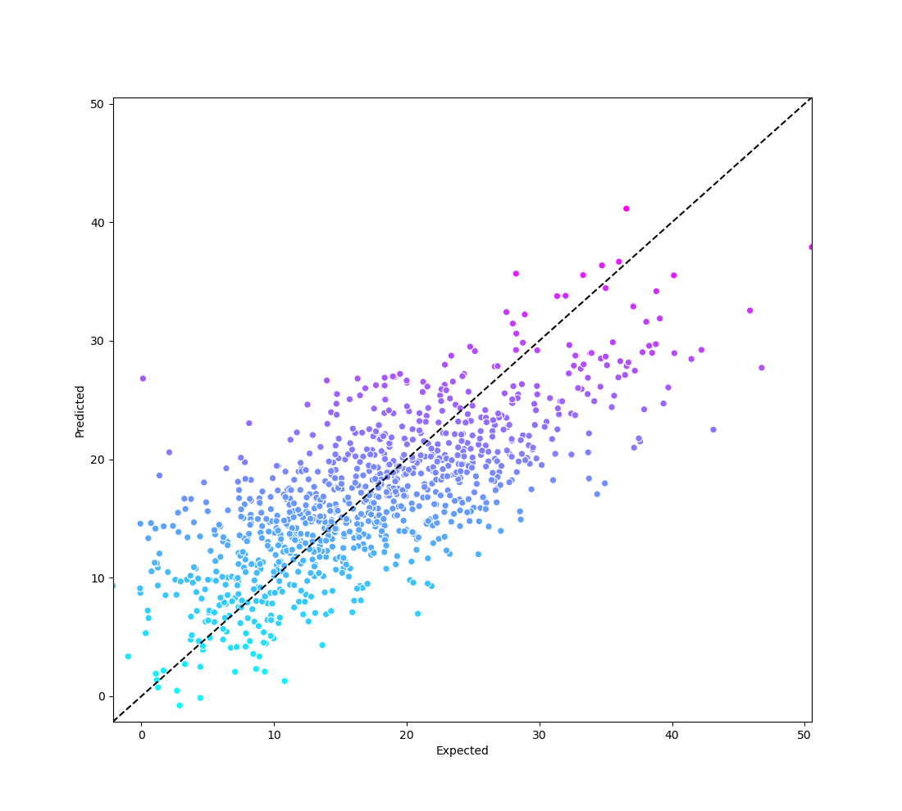
Multiple linear regression
80:20 Training Set to Test Set Ratio
r² = .551
MAE = 4.68 points

Slide 7
Artificial Neural Network
80:20 Training Set to Test Set Ratio
Initial Parameters:
22 Inputs,
22 Neurons per Hidden Layer,
2 Hidden Layers,
Batch size: 50
Epochs: 1,000
Activation function: Linear
MAE = 4.78 points

Slide 8
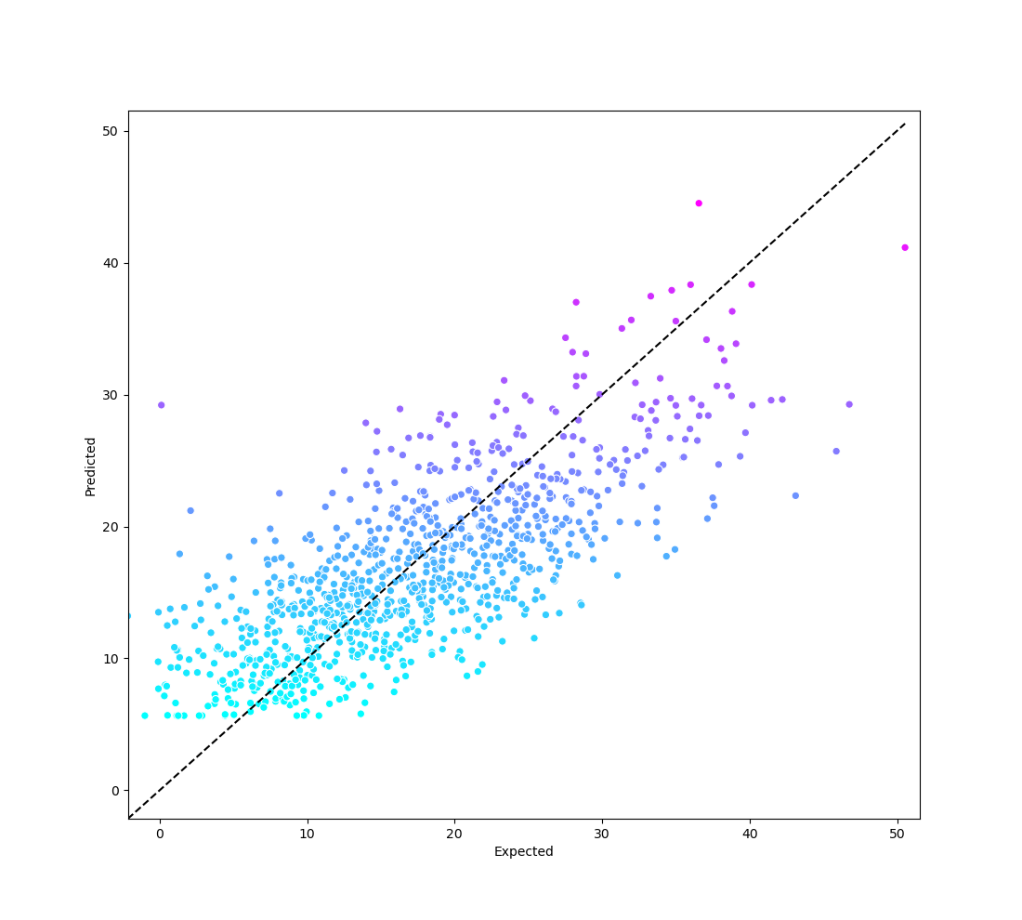
Artificial Neural Network
80:20 Training Set to Test Set Ratio
Initial Parameters:
6 Inputs,
6 Neurons per Hidden Layer,
3 Hidden Layers,
Batch size: 50
Epochs: 1,000
Activation function: Linear
MAE = 4.63 points

Slide 9
Unseen Dataset
Same features for the Quarterbacks who played in the Super Bowl between 2011 and 2019.

Slide 10
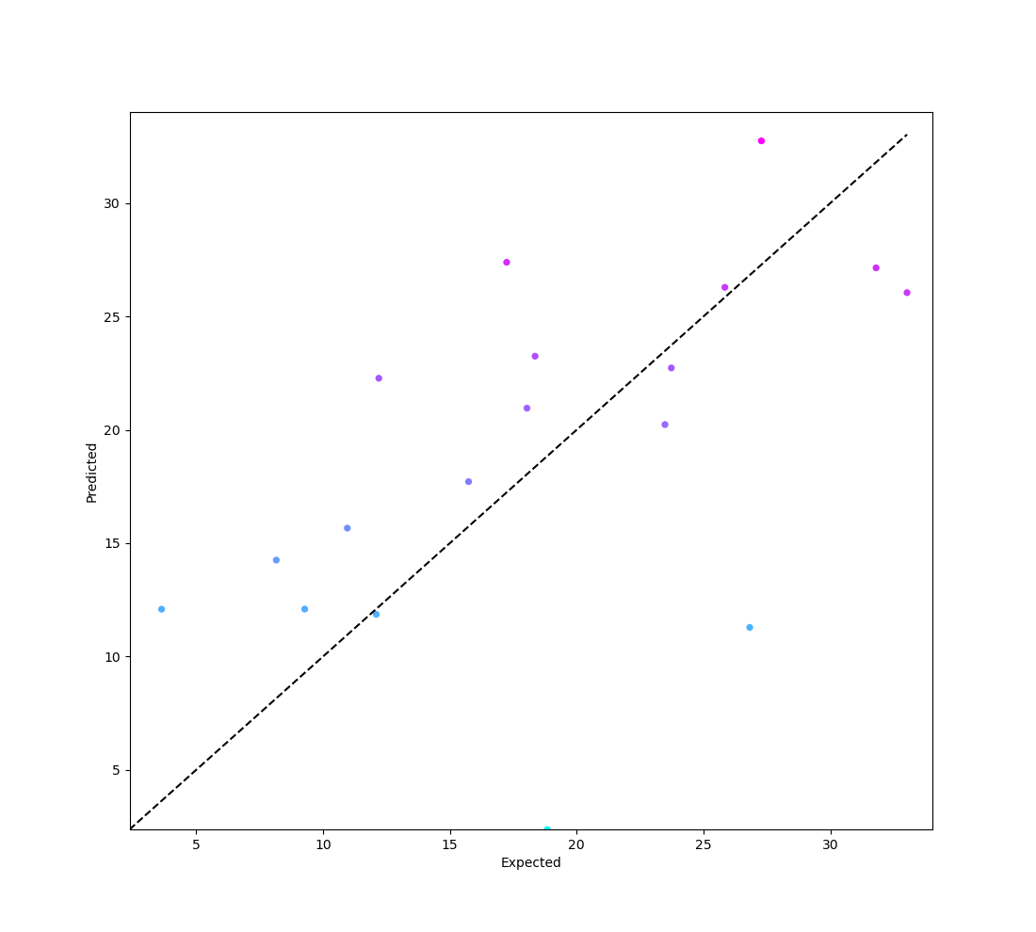
Multiple linear regression – Super Bowl
r² = .163
MAE = 5.89 points

Slide 11
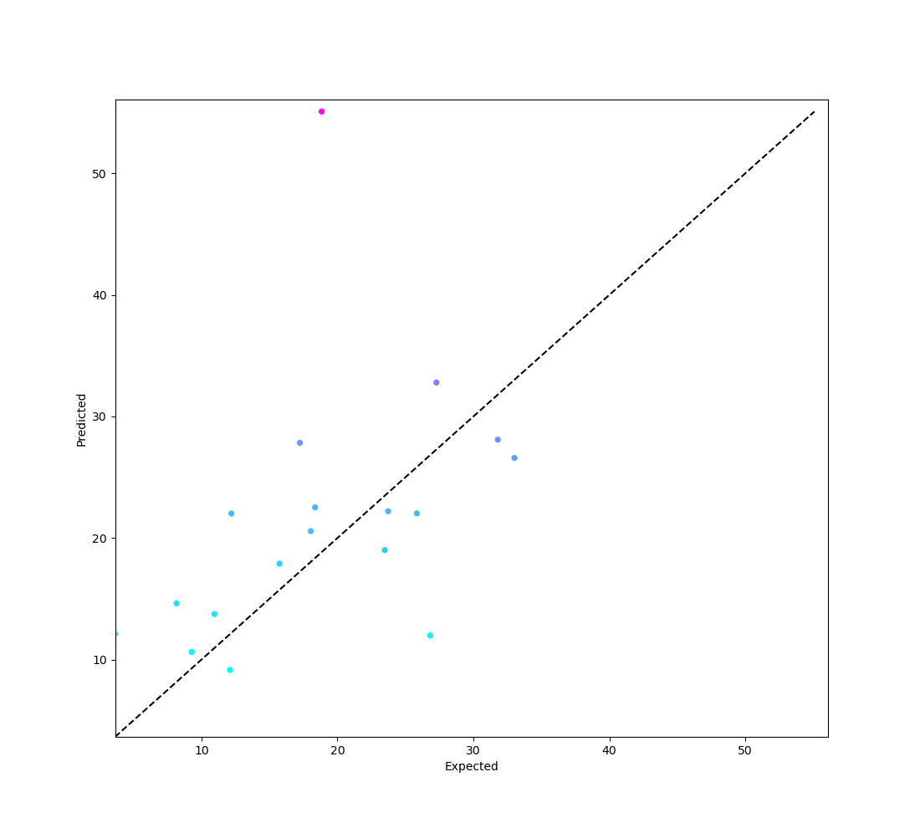
Artificial Neural Network – Super Bowl
MAE = 7.37 points

Slide 12
Key Takeaways
For fantasy sports points players, an accepted error rate may be beneficial because a Quarterback’s fantasy points for any given game could be projected to fall within a range.
For both models, at least 52% of expected fantasy point values were greater than predicted values.
For both models, at least 25% of predicted fantasy point values were within 2 points of the expected values.

Slide 13
Ways to Improve
Test other models/algorithms.
Test against larger unseen datasets.
Explore new, unused features:
Time of possession.
Snap/play count.
Team’s average passing/rushing play ratio.
Probability of games where they hit their season average statistics.

